Slide 1


Hospital Patient Flow & Medical Services Analytics
Healthcare Analytics

Slide 2


Objective
Analyze hospital efficiency and patient care using admission, treatment, and doctor performance data to uncover bottlenecks, improve outcomes, and optimize resources and revenue.

Slide 3


Data Cleaning & Transformation:
No missing values or outliers were found in the datasets.
Removed unnecessary white spaces from all fields to ensure consistency.
Admission and discharge dates were standardized to DD-MM-YYYY format.
Length of stay was calculated using admission and discharge dates.
Found data discrepancies and duplicates in doctor id values and replaced incorrect IDs with standardized values.
Prepared a clean, consistent, and analysis-ready dataset for further analysis

Slide 4


Admissions Trend & Cost Analysis by Department
Task 1
A. Calculate the number of admissions per department per month
Insights:
Admissions remained steady across departments, mostly ranging between 480–550 per month.
Slight peaks were observed in March, October, and December. Emergency & Pediatrics together handle ~25% of total hospital admissions annually, each crossing 6,300 patients.
B. Find the average treatment cost per department
Insights:
The analysis revealed that average treatment cost remained uniform across all departments, indicating a standardized pricing model.

Slide 5


Top Performing Doctors & recovery rate by age group
Task 2
Join admissions with doctors to identify top performing doctors by department.
Insights:
Scarcity of top talent (15 of 10,000) highlights dangerous single-doctor dependency training other rising stars through top performers is essential to handle growing patient volumes.
B. Join treatments with patient data to evaluate recovery rate by age group.
Insights:
Recovery rates were consistently high across all age groups, with the 0–20 age group performing slightly better (80.19%). This indicates effective treatment delivery and stable outcomes across demographics, suggesting no immediate need for age-specific interventions.
Age group | Total patients | Recovered patients | Recovery rate%
0-20 | 20913 | 16771 | 80.19
21-40 | 20059 | 15947 | 79.65
41-60 | 19862 | 15885 | 79.98
61-80 | 20115 | 16007 | 79.58
80+ | 19051 | 15189 | 79.73

Slide 6

Treatment and Admission Trends
Task 3
A. Calculate moving average of daily admissions (7-day MA)
Insights:
The 7-day moving average showed admission spikes in January, March, July, and Oct–Dec aligning with seasonal changes and increased healthcare demand.
These trends can help in resource planning, highlights need for proactive staffing, and capacity management during peak periods.
Rank doctors by number of successful treatments per month
Insights:
Each month, multiple doctors achieved top treatment success (3+ cases), showing consistent clinical performance across departments.
Over 80% of treatments were successful, indicating a high standard of patient care.

Slide 7

Cost & Length of stay
Task 4
A. Calculate 25th, 50th, and 75th percentile of treatment costs per treatment type.
Insights:
All patients are charged the exact same amount ($10,169.09) for every treatment type Consultation, Medication, Surgery, and Therapy.
There is no variation in treatment costs, as shown by identical values for the 25th, 50th, and 75th percentiles which may reflect a data quality issue.
B. Find the median length of stay per department.
Insights:
Most departments show a median patient stay around 10–11 days, indicating consistent hospitalization durations across specialties.
Departments like Cardiology and Emergency show slightly longer stays, possibly reflecting more complex or critical cases.

Slide 8

Patients by risk level & weekday vs END
Task 5
A- Group patients into 'High-Risk', 'Moderate-Risk', 'Low-Risk' based on comorbidity count
Insights:
In the absence of comorbidity data, patients were risk-classified using length of stay. Longer stays often indicate serious conditions, complications, or multiple diagnoses (comorbidities).
Out of 100,000 patients, 35% are High-Risk (35,049), 35% Moderate-Risk (34,739), and 30% Low-Risk (30,212), highlighting the need for tailored care strategies rather than just routine care.
Risk Level | Patients
High-Risk (Long stays (≥14 days) | 35,049
Moderate-Risk (Medium stays (7–13 days) | 34,739
Low-Risk (Short stays (≤ 6 days) | 30,212
Grand Total | 100000
B. Find admission trends by weekday and weekend.
Insights:
While total admissions over three years are higher on weekdays (~71,000) than weekends (~28,000), the average admissions per day are fairly consistent, indicating that daily patient volume is steady and the higher totals are due to more weekdays than weekend days

Slide 9

Performance & Patient Flow Analysis
Task 6
A. Find doctors whose patients had recovery rate above the departmental average
Insights:
The analysis shows that out of 10K doctors, 1K (10%) consistently achieved recovery rates above their departmental average, demonstrating stronger patient outcomes.
This highlights an opportunity to leverage high-performing doctors standardize successful treatment protocols, and focus improvement efforts on departments with fewer above-average performers to raise overall recovery rates.
B- Identify patients who visited more than 3 departments in a year
Insights:
No patients visited more than 3 departments in a single year.
This indicates that patient cases are generally handled within fewer specialties, which may reflect streamlined treatment processes or lower incidence of multi-specialty conditions

Slide 10

Yearly Trends & Peak Months
Task 7
A- Calculate year-over-year change in total treatments administered.
Insights
From 2022 to 2023, total treatments rose slightly by 1.23% (36,213 → 36,657). In 2024, the count appears to drop sharply by -25.99% to 27,130.
The -25.99% drop in 2024 (27,130) is due to data covering only Jan–Sep, which is just ~200 fewer than 2023’s same period. With Oct–Dec typically high, 2024 may match or exceed 2023
B- Find the month with the highest treatment cost.
Insights:
In January 2024, total treatment costs reached ₹32.6M, the highest of the year driven mainly by routine treatments like consultations, medication, and therapy.
This likely reflects a post-holiday backlog as patients delayed care in December. The predictable surge allows for better staffing, scheduling, and targeted service offers to manage demand and boost revenue

Slide 11

Patient Readmission & Care Continuity
Task 8
Retention and Follow-up Analysis
A. Find patients readmitted within 30 days of discharge.
Insights
There are 3064 patients faced readmission within 30 days, with an average gap of 15 days signaling gaps in post-discharge care and opportunities for improved patient follow-up.
B. Calculate average interval between admissions for chronic patients
Insights
Chronic patients are readmitted roughly every 187 days, highlighting predictable bi-annual demand. This insight helps to understand the 6 month readmission pattern allows hospitals to implement preventive measures and monitor patients before their next expected admission

Slide 12

Key insights & Recommendations
The dashboard reveals key opportunities to improve hospital efficiency and patient outcomes
Seasonal Cost Shifts :January post-holiday surge ₹32.6M: use pre-holiday outreach, corporate wellness tie-ups, targeted promotions, and front-load staff, and medicines to manage demand and maximize revenue
Resource Planning: Ensure adequate medicines, beds, and staff to handle predictable patient inflow
Uneven Weekly Demand: With 71.5% of admissions on weekdays, schedule follow-ups, routine checkups, or minor procedures on weekends, and use weekends for training or non-critical services to balance load and optimize efficiency.
Proactive & Digital Care: Intervene early for moderate-risk patients to prevent escalation to high risk and elderly patients with apps or remote monitoring for continuous support

Slide 13
Specialty Risk : Some departments (like Cardiology) keep patients longer than others. Long stays mean fewer patients can be treated, reducing hospital revenue potential. Improve recovery processes in these departments to speed up discharges.
Leverage Star Performers :Top 10% of doctors exceed department recovery benchmarks; rotate them through underperforming units for skill diffusion.
Predictive & Analytical Care: Leverage historical data to identify likely readmissions and use patient feedback to explore links with holidays, events, or environmental factors for proactive interventions.
Department Expansion: Introduce a dedicated Dermatology service to capture growing skin and cosmetic care demand, attract new patients, boost revenue, and position the hospital as a one-stop care provider.

Slide 14
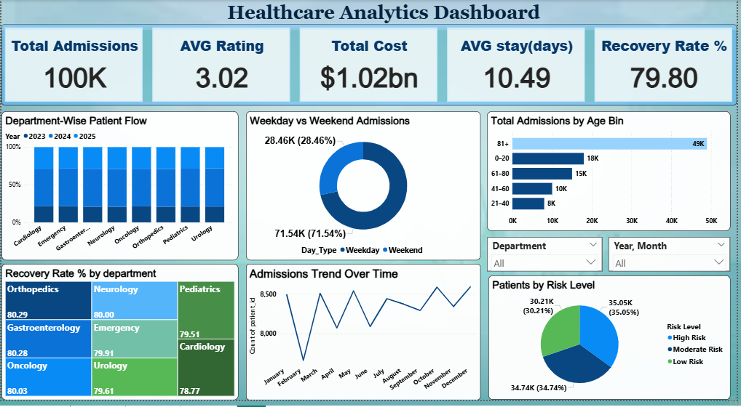
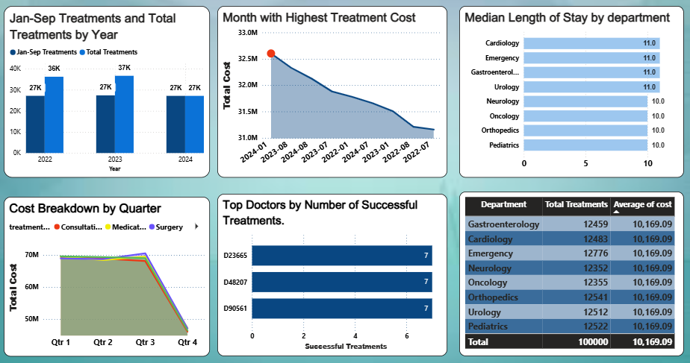
Dashboard

Slide 15

THANK YOU

